Slide 1



Land and Ice Applications of Scatterometer Data
David G. Long
Brigham Young University
Aug 2014

Slide 2

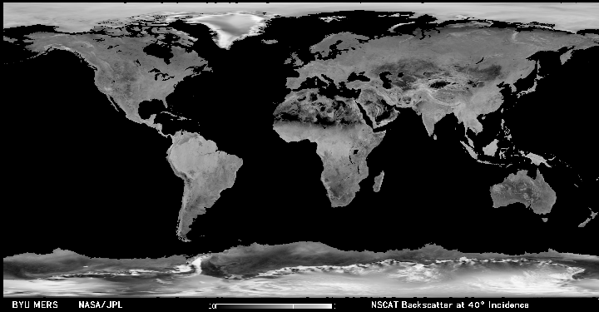
The World at
Ku-Band (14 GHz)
2

Slide 3
Scatterometers as Land & Ice
Observation Instruments
• Scatterometers are designed to measure vector winds to support long-term climate and air-sea interaction studies
• Also collect radar backscatter measurements over land/ice with frequent, all-weather global coverage
  - Backscatter is very sensitive to liquid water, vegetation characteristics & scattering mechanisms (roughness)
• Scatterometer backscatter data supports studies of
  Sea ice extent, age
  Freeze/Thaw conditions
  Flooding
  Oil spills
  Vegetation mapping
  Deforestation/change
  Urban growth
  “Land/ice winds” (sand and snow dunes)
  Greenland melt and accumulation
3

Slide 4
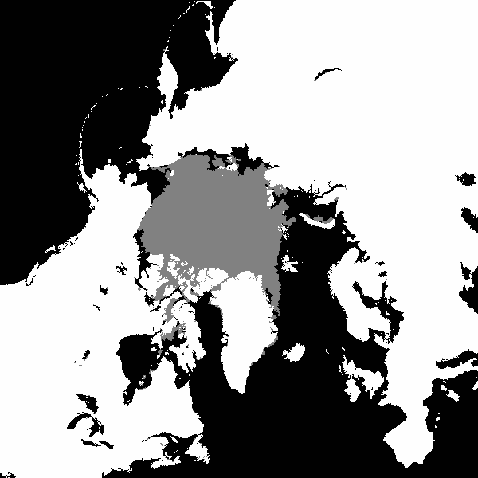
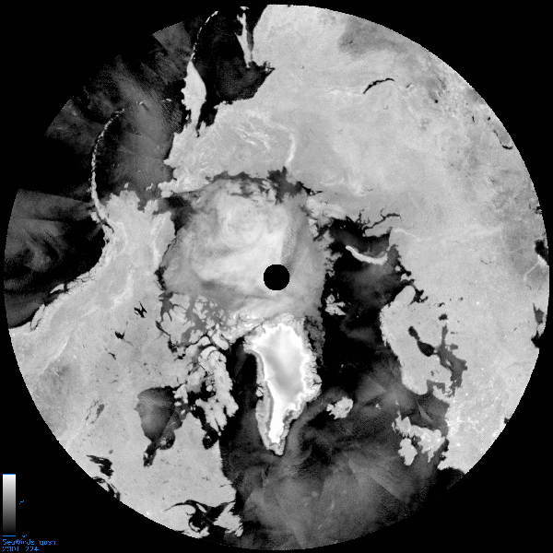
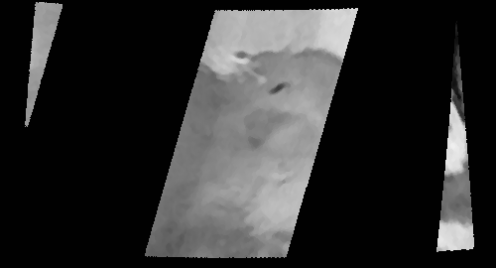
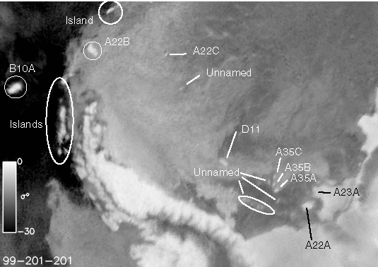
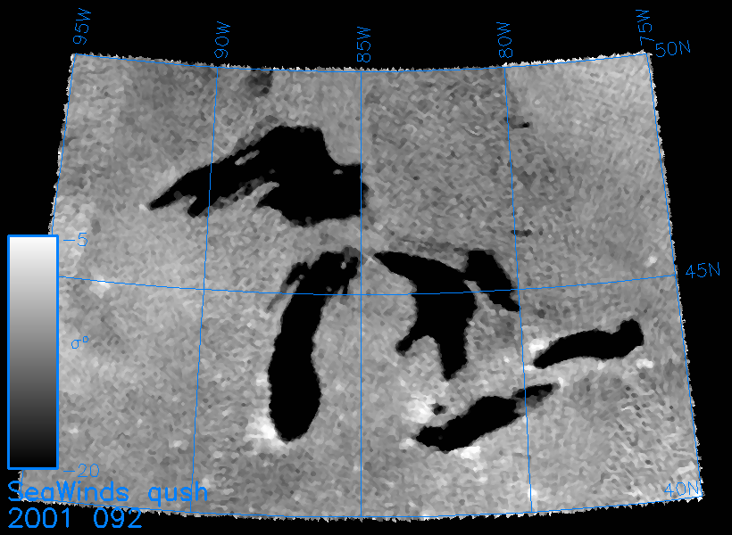
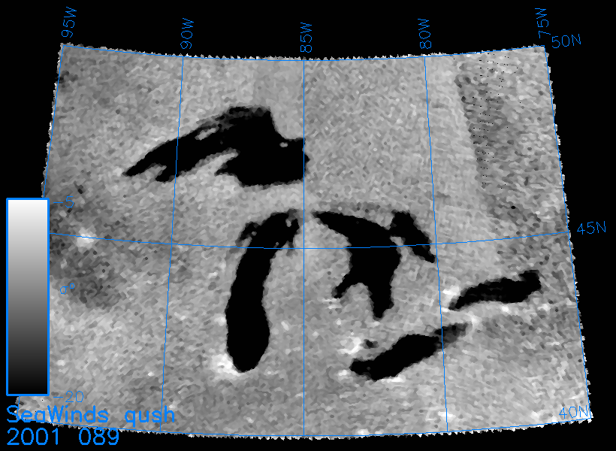
Some Land/Ice
Scatterometer Products
Sea ice extent & motion
Great Lakes ice monitoring
Oil spill monitoring
Iceberg tracking
ASCAT
QuikSCAT, OSCAT, ASCAT
Deep Water Horizion, JD 119, 2010
QuikSCAT, OSCAT, ASCAT
Changing ice cover JD 89-92, 2001
QuikSCAT, OSCAT
4

Slide 5
Sea Ice Science
Sea ice motion related to wind and currents
  Infer currents (and freshwater transport) from wind and ice motion
Sea ice characteristics (e.g., ice concentration, thickness, age, snow depth, ponding, drag coefficient, freeze/thaw, sea ice motion) are critical inputs to climate models and studies of air/sea fluxes
  Scatterometer data has been show to be effective for sea ice observation & to complement passive microwave observations
Ka-band can enable finer resolution
  Closer to ice/land wind & flux determination
  Better sea ice motion inference
  Likely to present new capabilities
    Further study and validation needed
5

Slide 6
Dual-frequency Scatterometry
False color image (JD 217, 2008) from Ku-band QuikSCAT and C-band ASCAT.
  Red: QuikSCAT h-pol σº at 46º
  Green: QuikSCAT v-pol σº at 45º
  Blue: ASCAT v-pol σº at 40º
6

Slide 7
Land Scatterometry
Multiple frequencies provide greater insight into surface scattering mechanisms – and thus geophysical properties – than single channel systems
Example land applications at Ku- and C-bands
  Flooding, snow freeze/thaw, vegetation change, vegetation response to rain and near-coastal winds
A Ka-band channel offers
  Higher resolution capability benefits ice edge, oil spills, urban applications, near land/ice winds
  Increased sensitivity to snow & ice freeze/thaw state
  May benefit vegetation studies (classification and vigor)
  New insights and new science
7

Slide 8
Sample Scatterometer Land/Ice Applications
Sea ice extent, age
Freeze/Thaw conditions
Flooding
Oil spills
Vegetation mapping
Urban growth
“Land/ice winds” (via sand and snow dunes)
Greenland accumulation and melt
Key advantages of scatterometry for land/ice observation:
- Global coverage
- Frequent (often better than daily) revisit times
- Multiple azimuth angles and polarization
- Complements passive microwave observations w/higher resolution
- Helps place high resolution SAR observations in larger context
8

Slide 9
Deepwater Horizon Oil Spill
Enhanced Resolution C-band ASCAT Observations
Oil layer alters wave spectrum, resulting in visible effects in enhanced resolution sigma-0 images
Ka-band oil-spill detection will have higher resolution and be more sensitive than C-band example shown here
Oil spill
JD 119, 2010
9
Notes:
A serendipitous application of enhanced resolution ASCAT data is monitoring the recent oil spill in the Gulf of Mexico. This daily image sequence shows ASCAT observations of the oil spill. These images are being processed in near-real time. Note the growth of the affected area with time. The oil is visible due to suppression of the small wave spectrum, which looks like low wind speed. However, the spill is much easier to see in sigma-0 imagery, even with some potential confusion with naturally occurring low wind speed regions. Ka-band will p

Slide 10
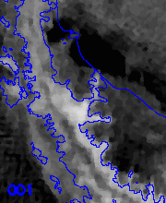
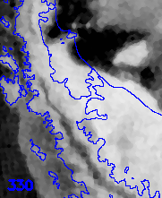
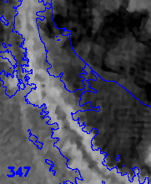
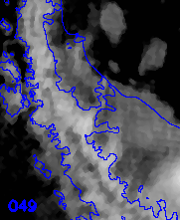
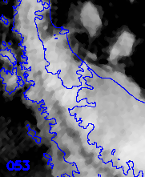
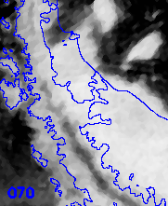
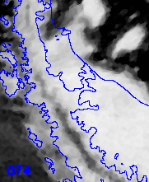
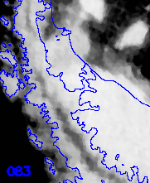
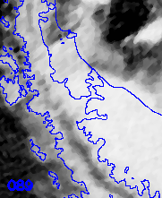
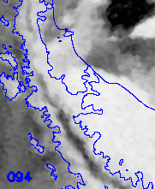
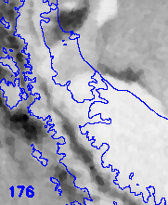
QuikSCAT Observations of the Larsen Ice Shelf Collapse
50 km
2002
10

Slide 11
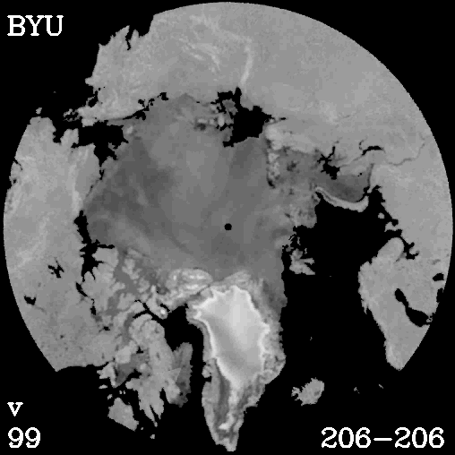
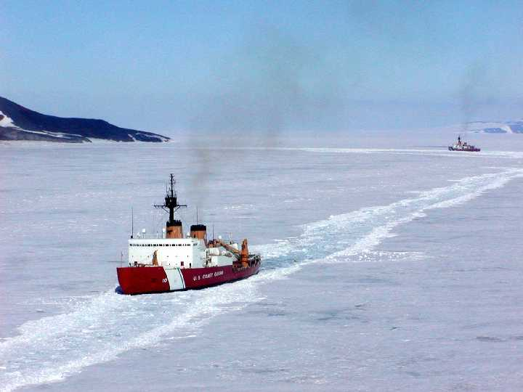
Sea Ice Extent
Sea ice mapping vital for shipping & climate studies
  Scatterometer data has higher resolution than radiometer data
  Can track features within the ice sheet
Ka-band offers finer resolution
(NOAA/NIC)
year
day
11
Notes:
Sea ice in the Arctic is much thicker and behaves somewhat differently than Antarctic ice since there is a floating permanent ice cap. In summer, only part of the sea ice melts. Summer melting causes the ice to appear darker to the radar. We can observe the passage of warm fronts over the poles and monitor tundra melting in Canada and Siberia as swirling patterns of light and dark in this animation. As summer progresses, the ice cap shrinks as it melts. In winter the ice pack grows, both larger and thicker. [pause] You may have heard stories about the shrinking Arctic ice cap in the news. Our data over the last decade confirms that the size of the summer sea ice pack in the Arctic is, in fact, shrinking, and that the ice cap is thinning. This is consistent with global warming. Paradoxically, we have also observed that sea ice extent during the winter has also grown.
I want to note that our radar images are operationally used by the Navy and international agencies to aid in ship routing, as well as monitoring climate.

Slide 12
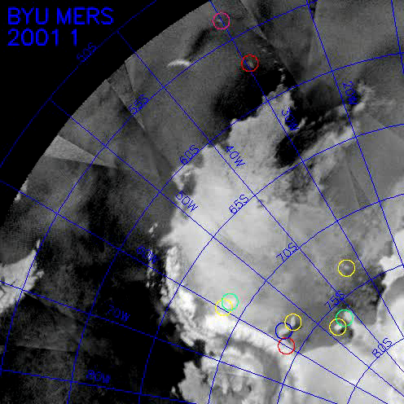
Iceberg Tracking
Icebergs in radar images
  Visible due to contrast between ice & ocean
  Not affected by illumination or cloud cover
  Tracking likely to be aided by including Ka-band measurements
ASCAT iceberg tracking at NOAA using BYU-developed software
Direct ships to locate and study icebergs in situ
12
Notes:
Our radar image data is now operationally used by iceberg trackers at the National Ice Center. BYU has become a primary source of iceberg tracking information. Twice a week we provide updated iceberg tracking information, which is broadcast worldwide for ship warnings. In many cases, BYU is the only source of an iceberg’s location, which is ironic [with humor] since we don’t see very many icebergs in Utah. [pause] In this animation, circles show the locations of the icebergs we tracked over a one year period. Note the dynamic motion of both the icebergs and the sea ice. Our success in using scatterometer data to track icebergs has enabled us to address a number of important scientific questions. (slow down)

Slide 13
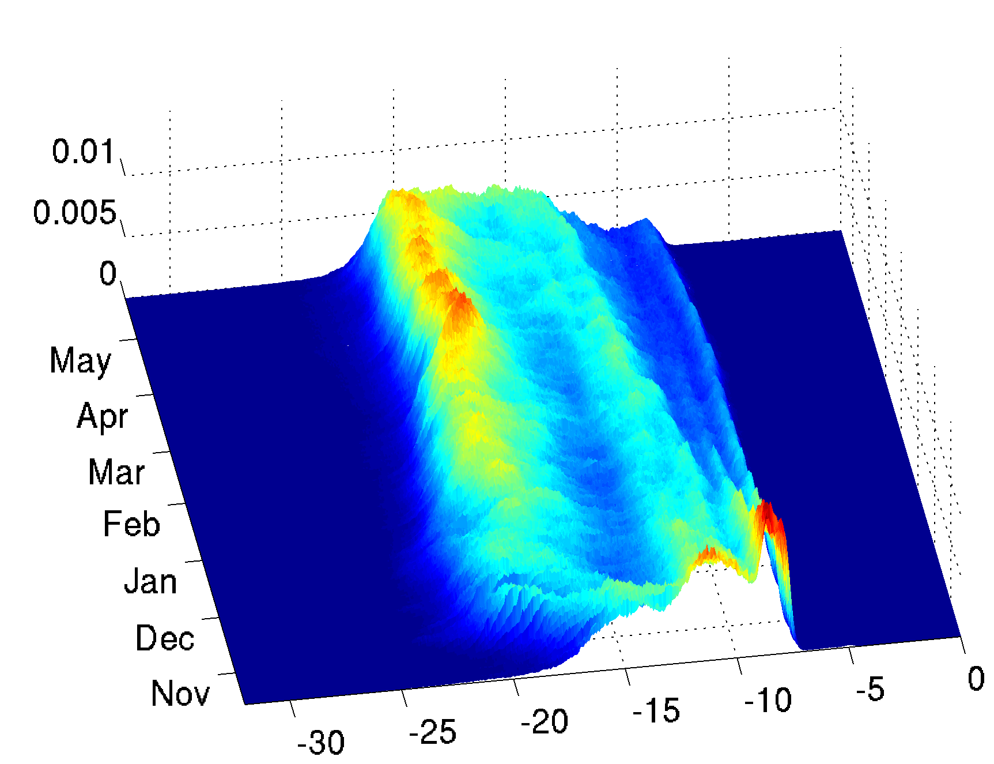
QuikSCAT MY Ice Mapping and Temporal Trends in Sea Ice Backscatter
Scatterometer Ice Age Measurement
QuikSCAT sigma-0 histograms (normalized to pdfs) plotted for each day of the year
Ku-band backscatter is strongly sensitivity to FY and MY ice
Distinction between ice types is related to
  Ice salinity
  Porosity
  Surface roughness
  Ridge structure
Total FY ice grows during winter
Winter
2006-2007
MY Ice
FY Ice
A.M. Swan and D.G. Long, “Multi-Year Arctic Sea Ice Classification Using QuikSCAT,” IEEE Transactions on Geoscience and Remote Sensing, Vol. 50, No. 9, pp. 3317-3326, 2012.
QuikSCAT VV (σ⁰ in dB)
13

Slide 14
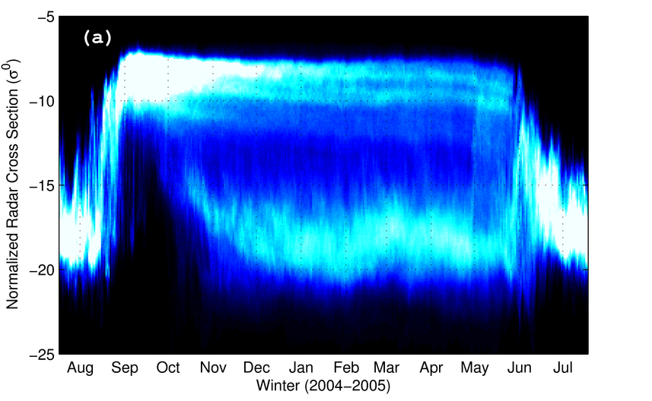
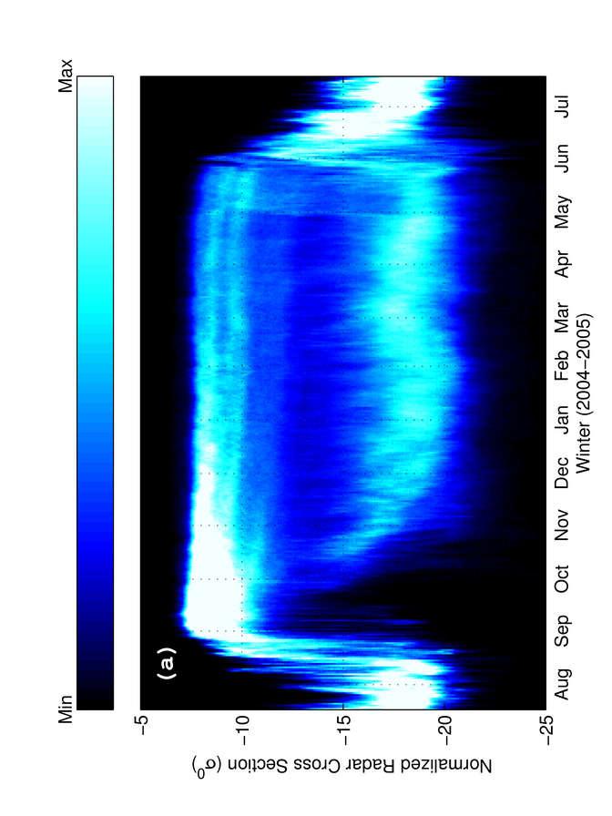
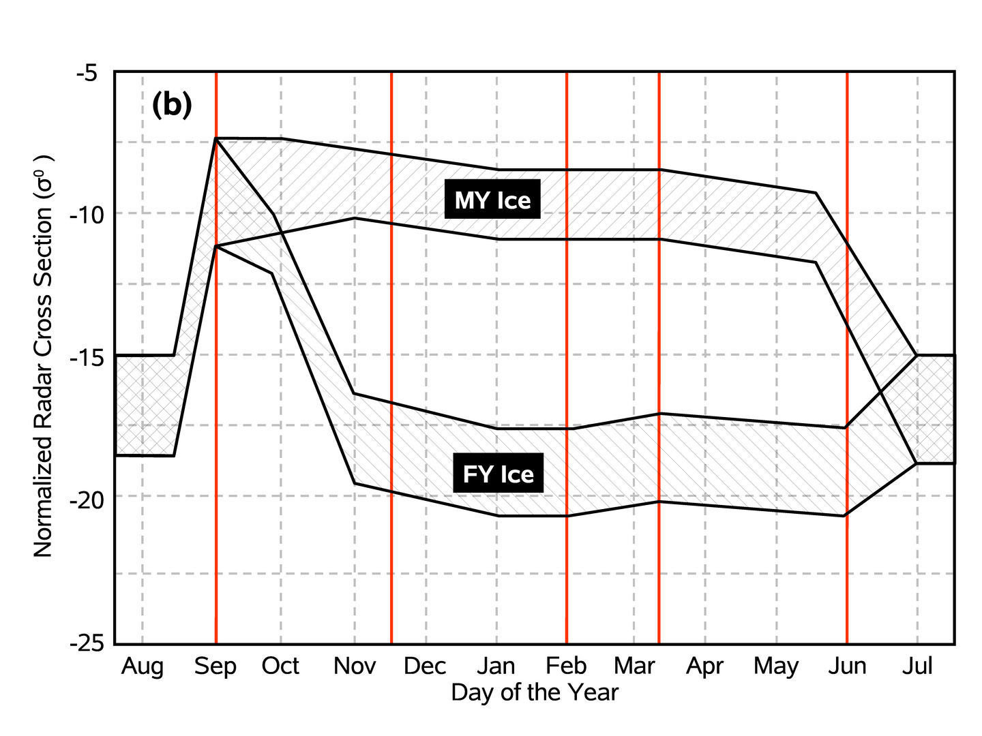
Sea Ice Trends
Max
Scatterometer Ice Age Classification
pdf of backscatter versus time of year
Seasonal trends in backscatter of FY and MY ice
The cartoon shows approximate trends observed each year
FY area grows through winter, MY roughly constant area
Min
14

Slide 15
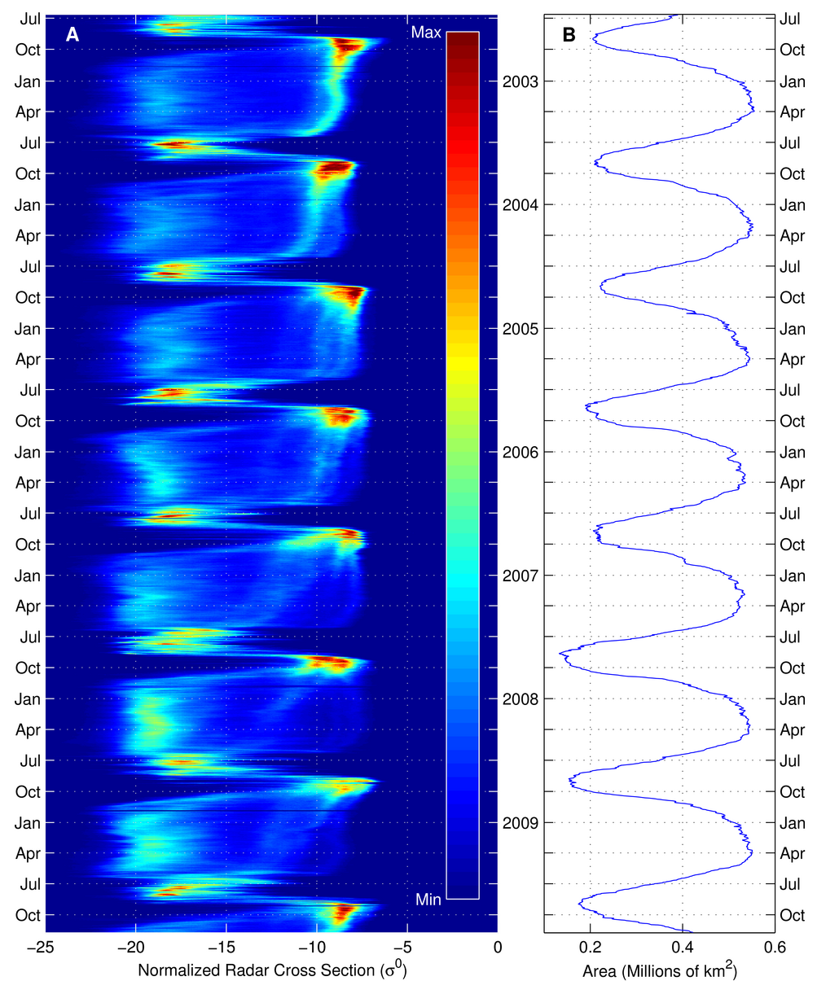
Multi-year Sea Ice Trends
(a)
(b)
Distributions in (a) are approximately bimodal
There is a shift in the modes of FY and MY ice
Total area of ice in (b) is similar each winter
Conclude that FY ice is replacing MY ice
First year ice
Multi-year ice
15

Slide 16
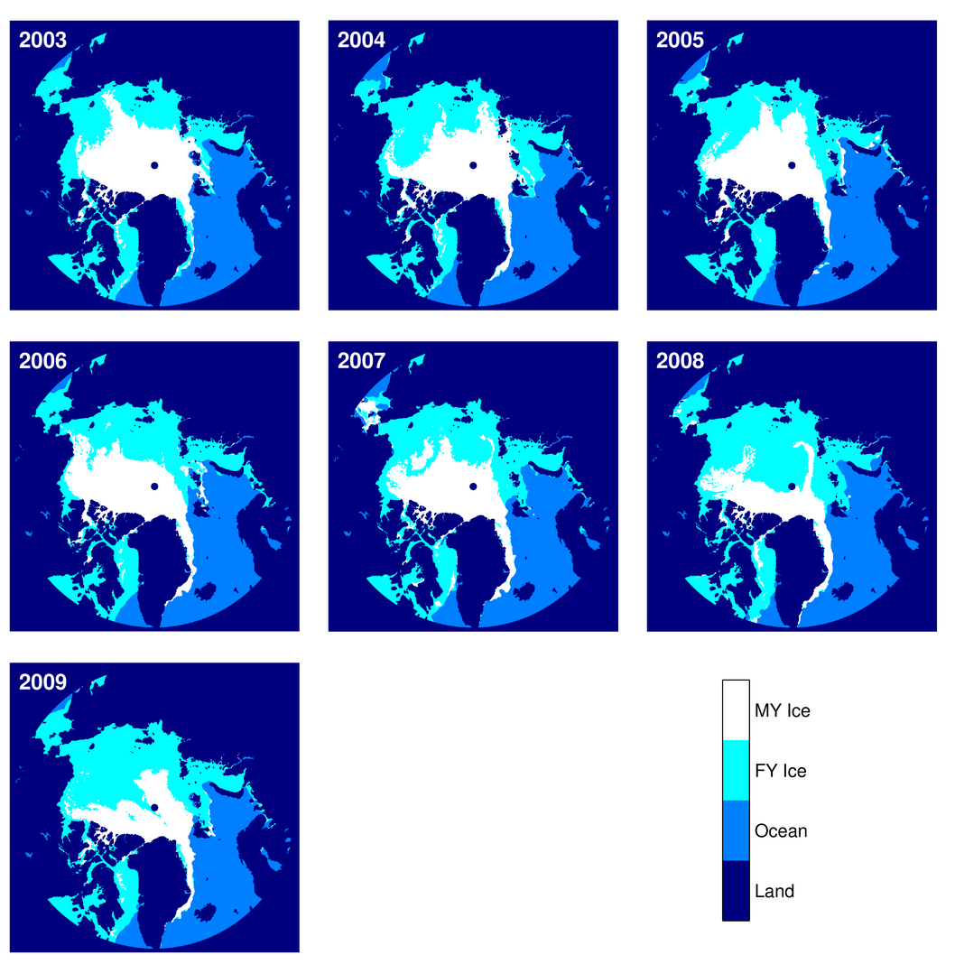
Sea ice Thickness (FY/MY) Mapping
From QuikSCAT
16
Notes:
Changes in thickness are related to transport and to freeze/melt, which can be tied into the Arctic science activities. Improved tracking from high resolution Ka-band will presumably reduce errors, making the ice classification and freeze/thaw more accurate.

Slide 17
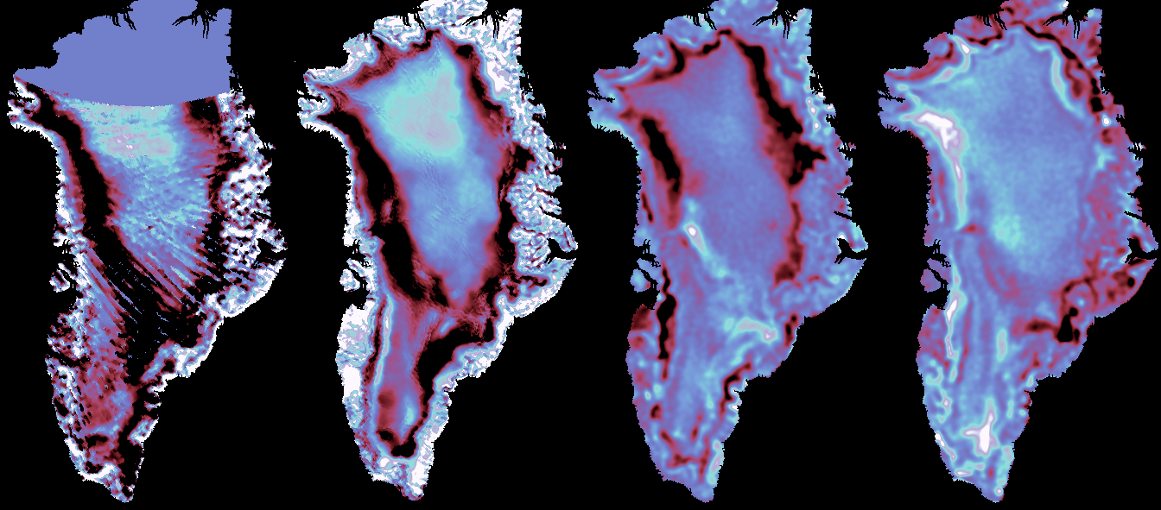
Multi-Decade Change
Greenland
Accumulation
change in radar backscatter
Melt
-1 dB
1 dB
1978
1996
2000
2008
SASS
NSCAT
SeaWinds
SeaWinds
17
Notes:
Here are false-color radar images of Greenland over the past 3 decades. The images show the difference between the radar backscatter for the year and the 30-year average backscatter. The dark colors along the periphery in 1978 and 1996 are due to less melt in these early years than at present, [click] while the lighter colors in 2000 and 2008 suggest that more melting is occurring now. This is consistent with a warming pattern in Greenland and is a very strong evidence of climate change. [click] As if to prove climate is complex, at the top of Greenland, the color is darker in 2008 than it was in 1978. This indicates that snow accumulation is greater now than it was 30 years ago in this area. This observation is also consistent with global warming, since warmer weather causes more evaporation, which results in more precipitation and snow, at least in some locations. So, we have more melting and more snow. [pause] Which is winning: more melt or more accumulation? [pause] Careful analysis of the data shows that increased melting is winning. Greenland is warming and as it warms, it is melting, releasing the water that it has stored as ice into the ocean and raising sea level. The rise in sea level is small so far, but could accelerate as the flow of glacial ice is lubricated by the melting water. (slow down)

Slide 18
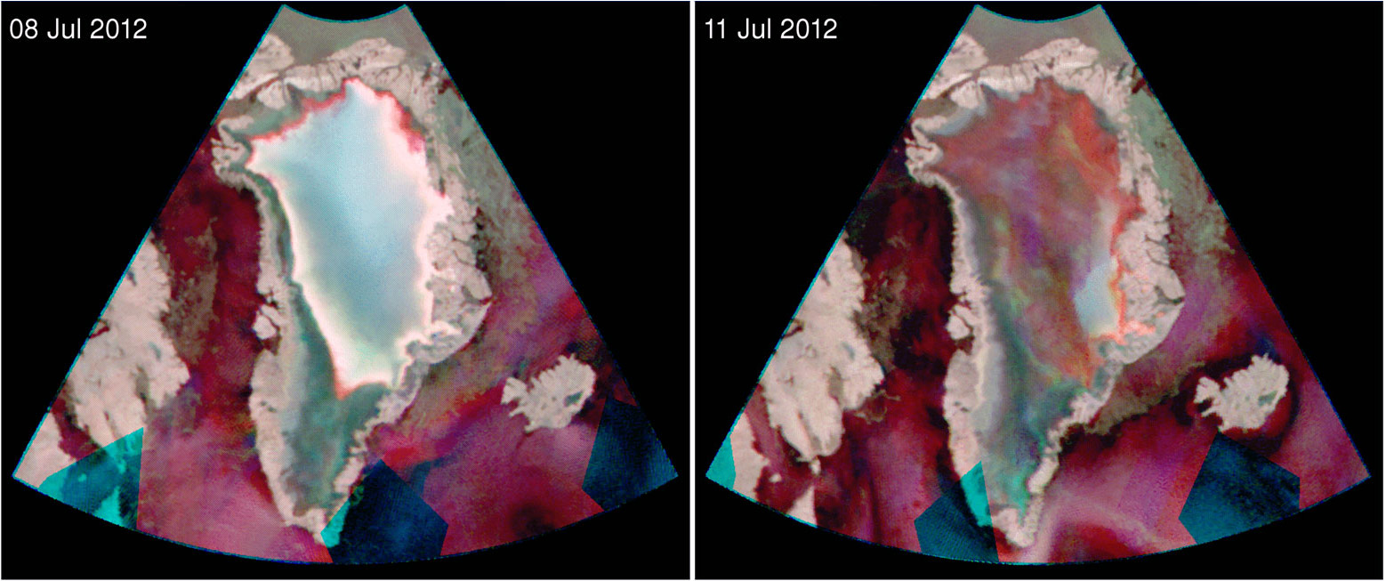
Greenland Summer Melt
During the Summer of 2012, Greenland endured one of the largest areal melt cycle observed in the satellite record. The melt event was recorded by OSCAT and ASCAT.
False color RGB images from a single day of Ku-band data (Oceansat-2 H=Red, V=Grn) and C-band data (ASCAT=Blu). Land shows up as pink-grey. Deep melt is the green. Surface melt is red. Refrozen melt is bright white. Unmelted firn is dark grey/blue.
18

Slide 19
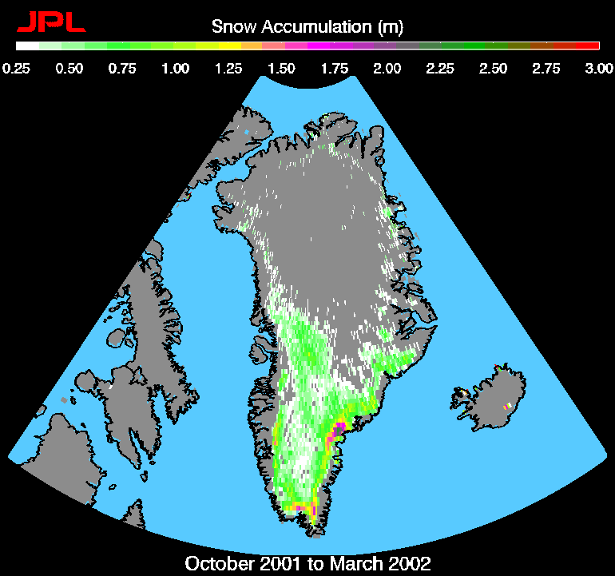
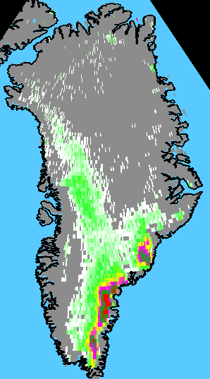
QuikSCAT Snow Accumulation Maps
Anomalous accumulation in 2002-2003
First maps of snow accu- mulations (depth in meter, 5.5 months Oct.-Mar.) in
the percolation zone seen by NASA QuikSCAT data.
Satellite results agrees to within 8.6% compared to in-situ data at NASA-SE automatic weather station.
Detection of severe accu- mulation (~double normal amount) in SE Greenland in 2002-2003.
Less accumulation in SE Greenland in 2002-2003.
2001-2002
2002-2003
19
Notes:
Changes in accumulation and freeze/melt can be tied into the Arctic science activities. Improved tracking from high resolution Ka-band will presumably reduce errors, making the freeze/thaw more accurate.

Slide 20
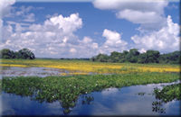
Mapping of inundation
Grasslands are frequently inundated seasonally. The Brazilian Pantanal is an example.
During the wet season from October to March, backscatter increases as ground becomes inundated and approaches bright values similar to Tropical Forest. As water recedes, backscatter decreases to yearly lows.
Pantanal during the wet season
20

Slide 21
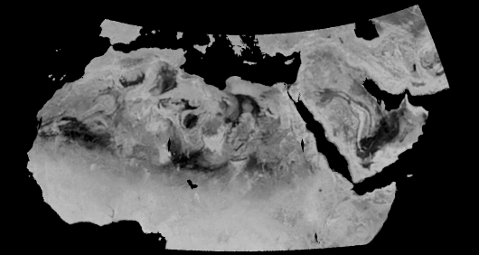
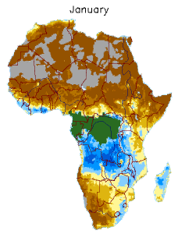
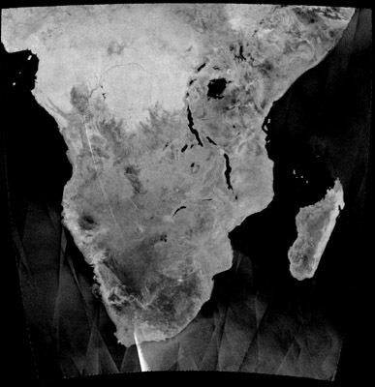
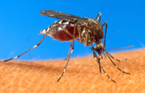

Drought & Flood Monitoring
(Malaria Prediction)
Scatterometer-based mapping of flooding and water inundation is especially useful for malaria risk mapping as mosquitoes begin life as aquatic larvae and adults rarely travel more than 2km from their breeding site in their two to three week lifetime. A number of organizations are using scatterometer data as input to models predicting malaria outbreaks related to flooding conditions.
21

Slide 22
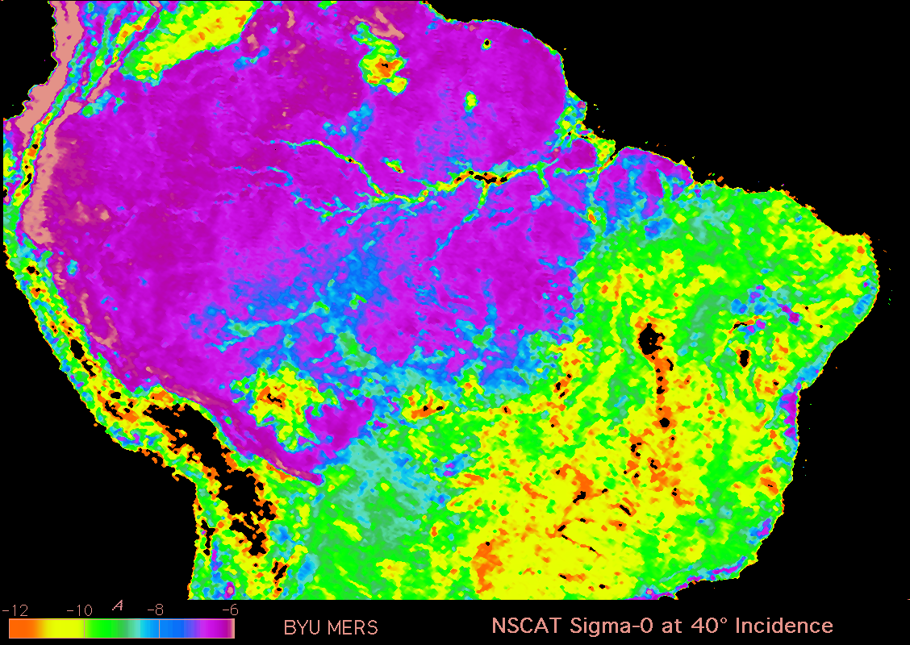
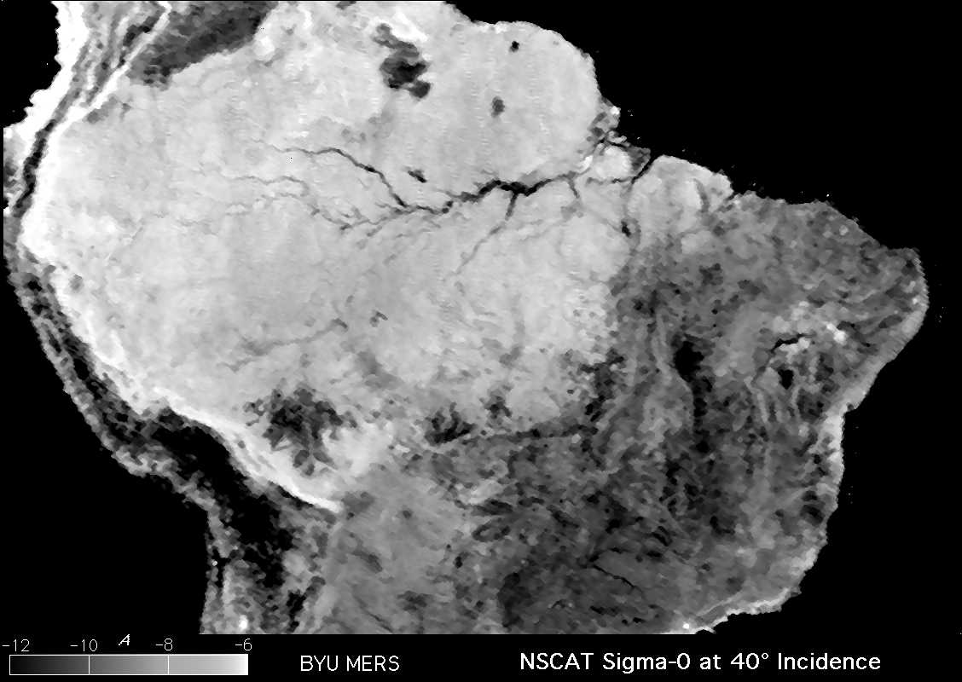
Vegetation Classification
22

Slide 23
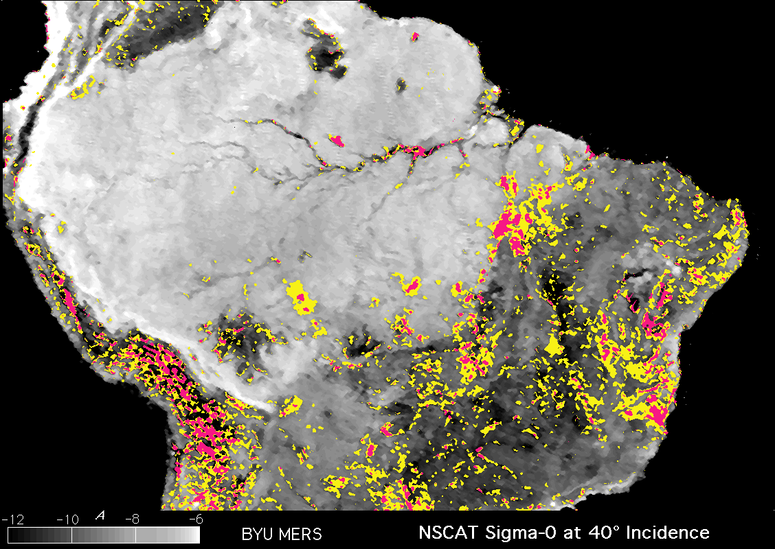
Amazon Deforestation
Change
1978-1996
Light area
is rainforest
Colors show areas of significant change
Mountain changes due to snow
Darker area is savannah & shrubland
radar backscatter
23
Notes:
Here is an example of how scatterometer data can be useful for studying change in tropical vegetation. This radar image shows part of South America. The light area is tropical rainforest (jungle), while the gray area is savannah and woodlands. The Amazon River system is visible as a branching set of black lines. Comparing radar data taken in 1978 and 1996, it is clear that extensive change has occurred. In this image, yellow marks mild changes, while pink indicates areas of significant change. The colored regions are associated with reservoir construction, road building, and human settlement. [pause] Significant fractions of inland and coastal rainforests have disappeared in the two decade period shown – and this trend has accelerated. This is only one example of how humans are rapidly changing land use on large scales. (slow down)

Slide 24
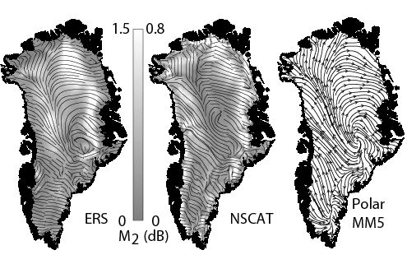
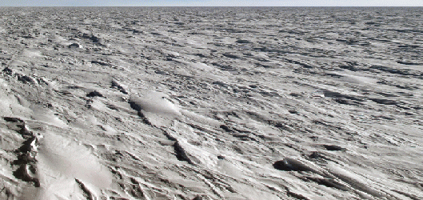
Wind Direction over
Greenland from snow dunes
sastrugi
Scatterometer-derived
Katabatic model
24
Notes:
Wind direction over snow-covered areas can be determined from scatterometer azimuth sigma-0 variation. Ka-band can be expected to improve sensitivity and detect changes in snow deposition related to near-coastl winds.

Slide 25
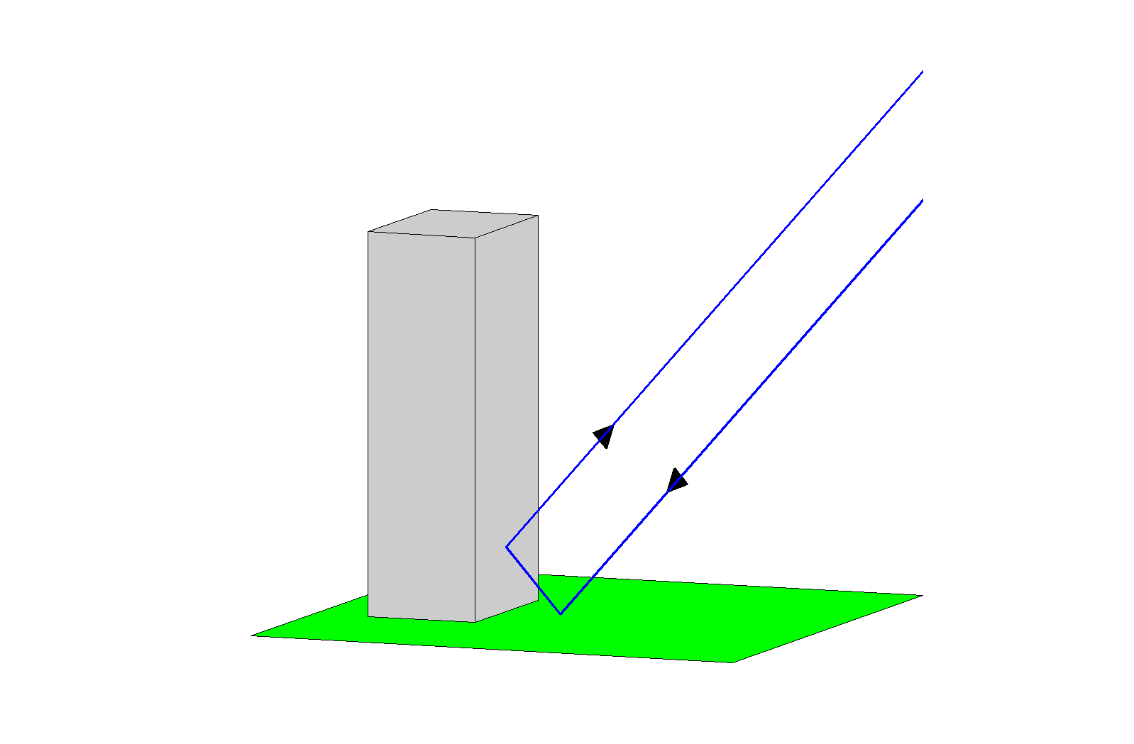
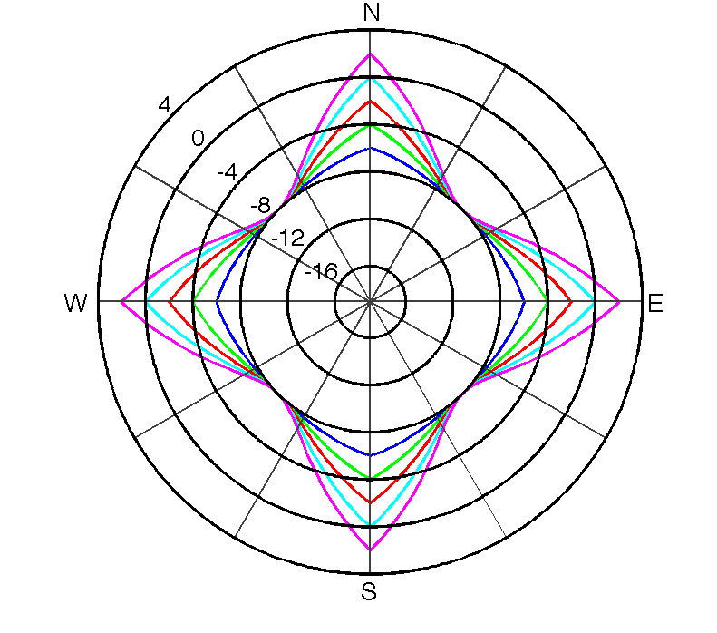
QuikSCAT σ⁰ Azimuth Response for Urban Areas
Building and ground acting as a dihedral corner reflector
Urban areas with regularly-gridded road systems exhibit σ⁰ azimuth responses consistent with dihedral corner reflectors
  - Building orientation consistent with road orientation
Density of buildings are proportional to signal strength
Azimuthal variations present to some extent in most urban areas
Seasonal variations exist for many urban areas
Each urban area response is unique and evolving over time
Illustrative observations from all azimuth angles for a single 4-sided dihedral corner reflector such as a building for various magnitude differences.
* From paper currently in review
25

Slide 26
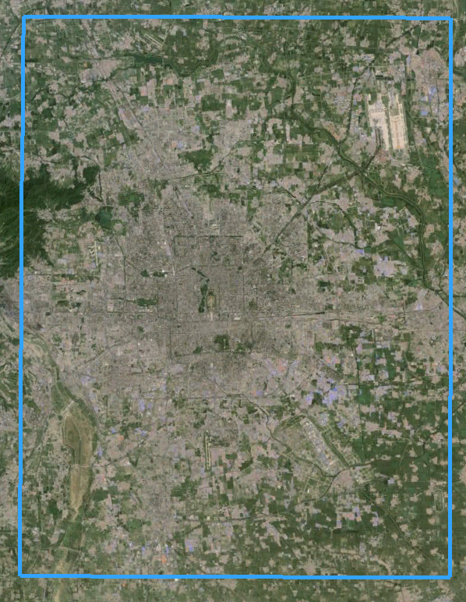
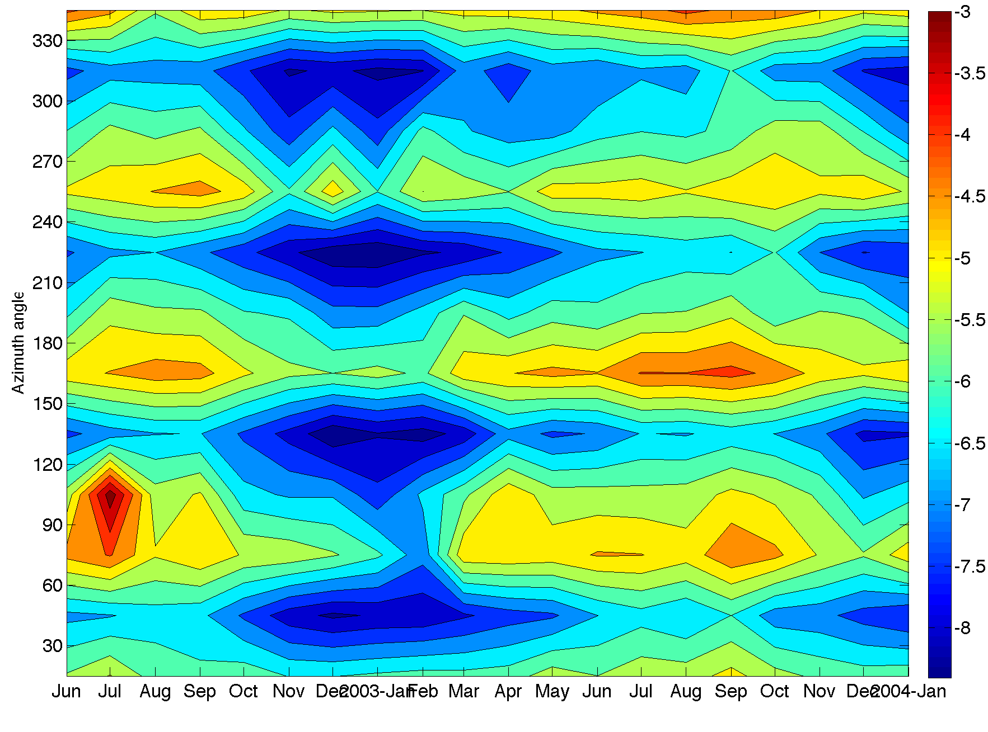
Beijing, China
observation
mean
1922 σ⁰ observations from 1 Jul - 31 Aug 2003
Azimuthal peaks
Monthly mean σ⁰
dB
Seasonal variations
* From paper currently in review

Slide 27
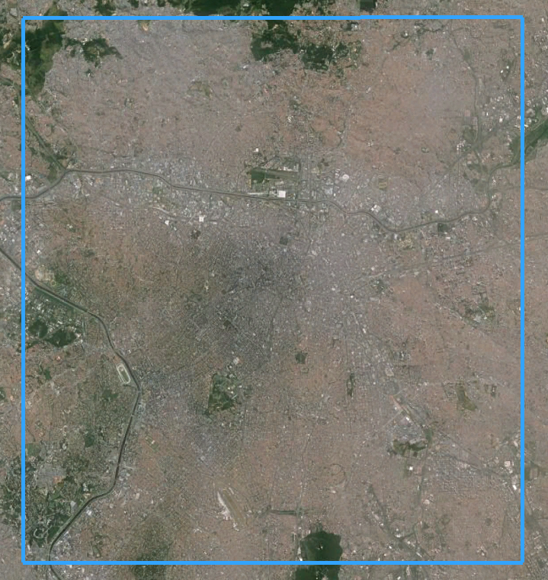
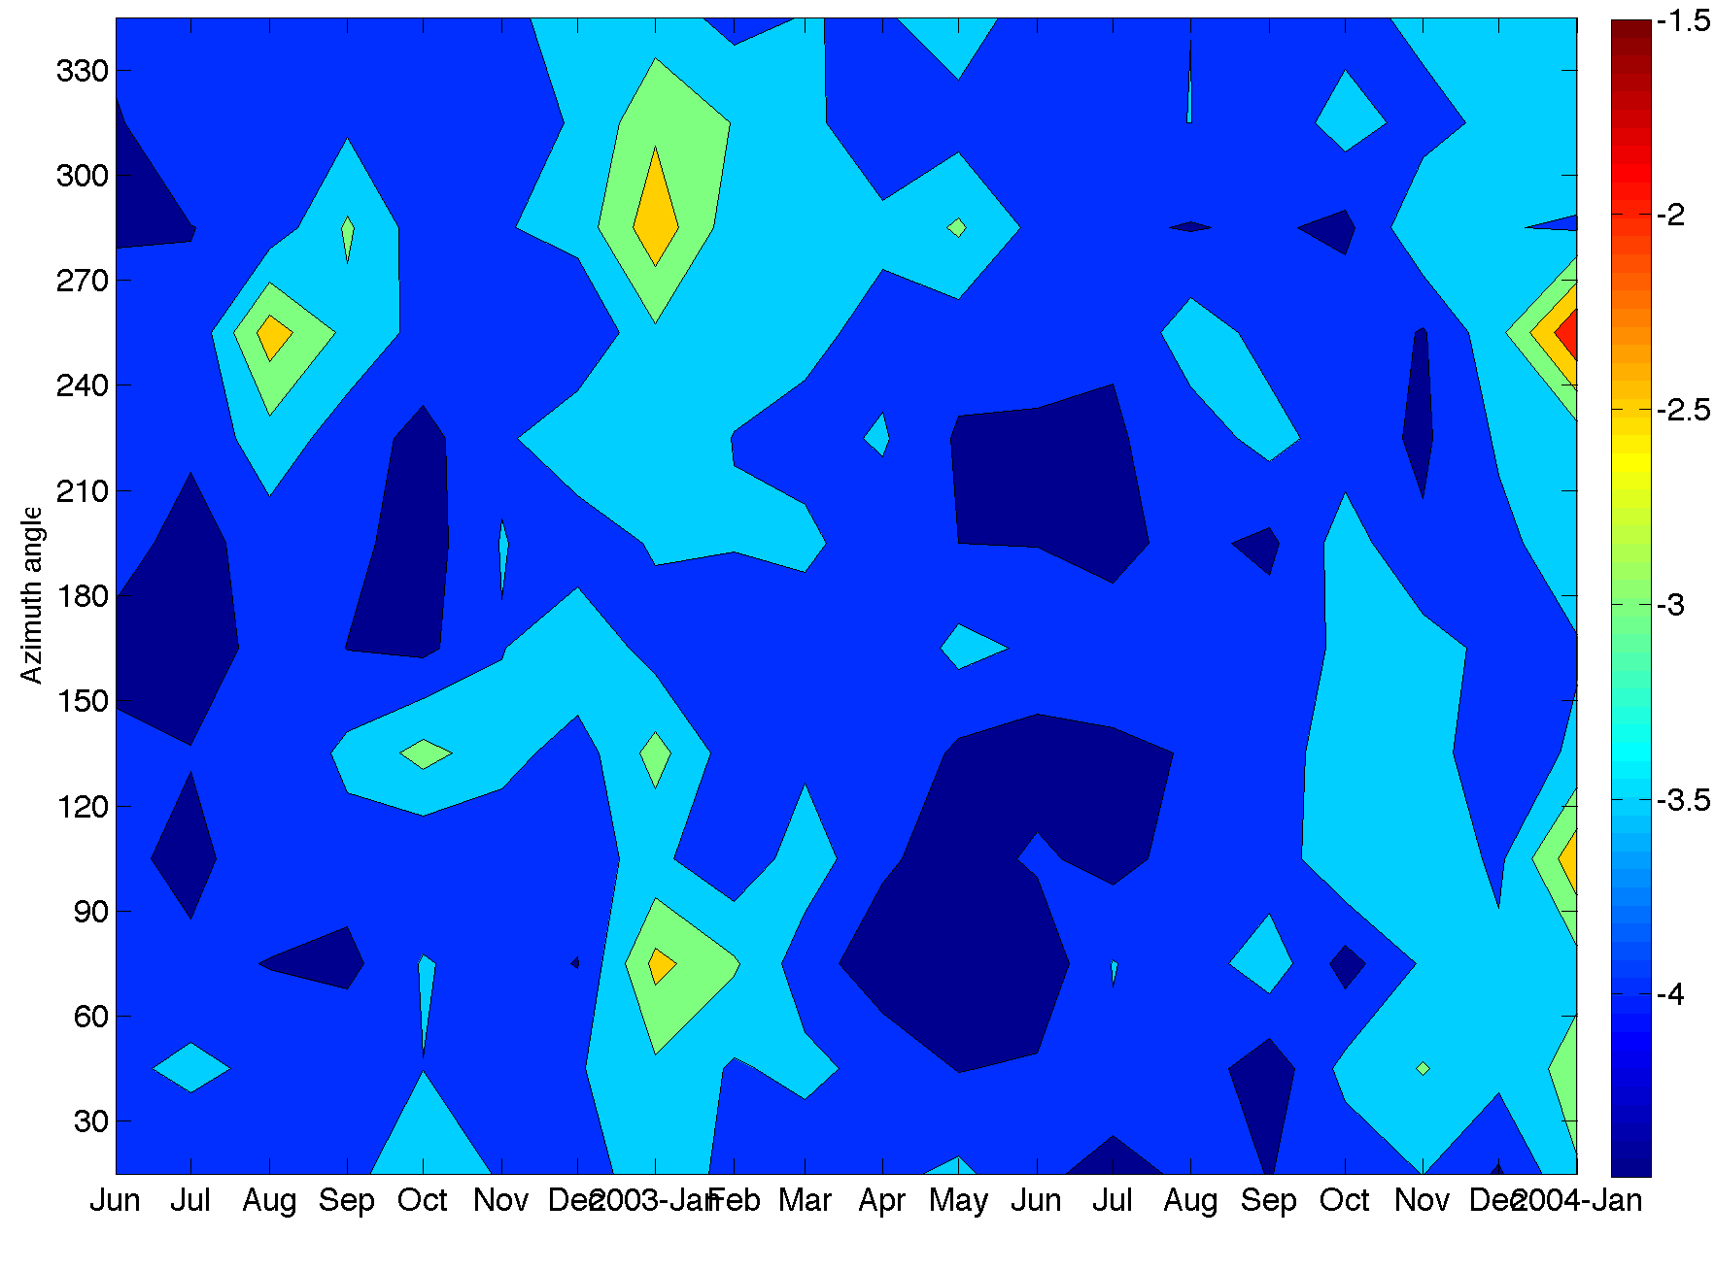
São Paulo, Brazil
observation
mean
333 σ⁰ observations from 1 Jul - 31 Aug 2003
Monthly mean σ⁰
dB
Seasonal variations
No dominant road structure -- no azimuthal peaks
* From paper currently in review

Slide 28
Conclusion
Scatterometer data is effective in land/ice studies
  Addition of Ka-band will improve sensitivity in many applications
  Potential to add new insights
NASA HQ has long recognized the contributions of scatterometry in land/ice observation by including such applications in calls for participation in the Ocean Vector Wind Science Team (OVWST)
  A number of OVWST members have specialized in such applications
  Scatterometer Climate Record Pathfinder (www.scp.byu.edu)
27

Slide 29
Backup Slides
28

Slide 30
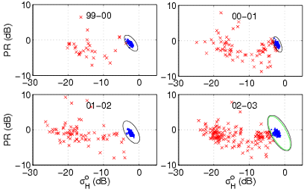
Antarctic Ice Shelf Melt Detection
Example
Use QuikSCAT backscatter polarization ratio, PR = σ_{v} – σ_{h} (dB), and σ_{h} time-series
Compute mean and covariance for specified non-melt and melt periods
Classify melt state using ML objective function
29

Slide 31
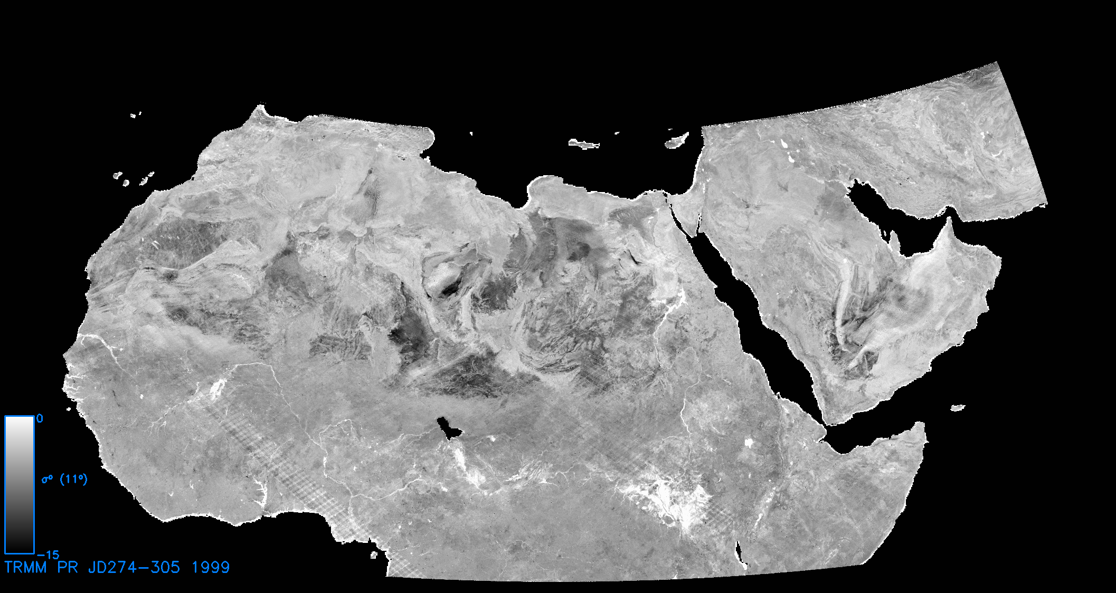
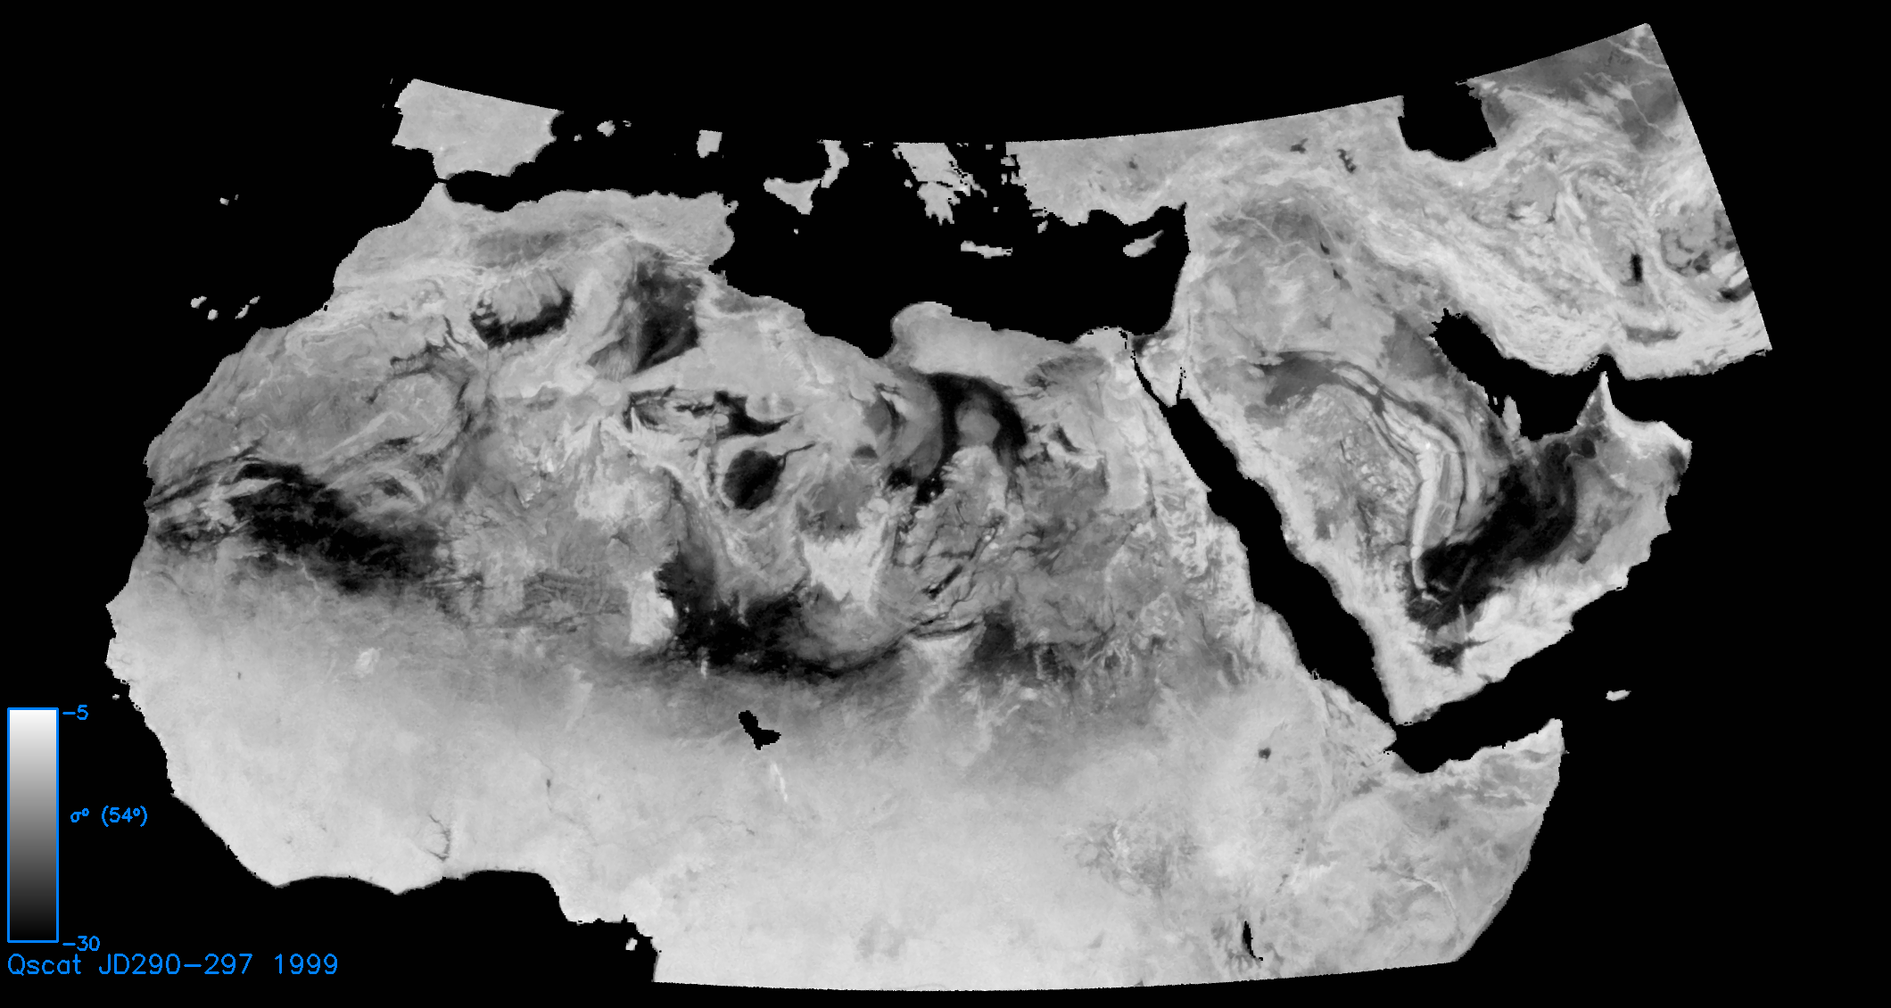
TRMM &
QuikSCAT
Desert
Observations
TRMM PR Sigma-0 Image
(normalized to 11º incidence)
The TRMM PR and the QuikSCAT scatterometer both operate at Ku-band, though at different incidence angles (0-17 deg vs 46 and 54 deg) and resolutions (4 km vs 25 km). Here the radar backscatter from North Africa is compared. Greater contrast between rocky desert regions and erg seas are evident at high incidence angle due to absorption of the radar signal within the sandy regions. Rivers and other water courses are more evident at low incidence angle due to strong specular scattering.
swamps
QuikSCAT Enhanced
Resolution Sigma-0
(at 54º incidence)
Sahel
ergs
Congo
rainforest
30
Notes:
The effects of the viewing geometry are even more apparent in Africa. The top image is from TRMM PR while the bottom image is from QuikSCAT. TRMM PR shows swamps well, but has less information about the great sand dunes seas (called ergs) than does QuikSCAT. Combining the two images gives us a much more comprehensive understanding of this continent. Notice how the northern part of Africa, which is mostly desert has lots of detail. As one moves south, the vegetation density increases and there is less detail. The bottom of the image is the Congo rainforest. The boundary of the desert is known as the Sahel (or shoreline in Arabic). Many people live in the Sahel and changes in the rainfall here cause droughts or flooding, displacing thousands of people.

Slide 32

Surface Roughness Geometry
(snow dune wind measurement)
Mean topographic slope with wind-generated sastrugi
sastrugi
31

